Slide 1


Higgs branch localization of
3d theories
Masazumi Honda
Harish-Chandra Research Institute
Ref.: arXiv:1312.3627 [hep-th]
Based on collaboration with
Masashi Fujitsuka (SOKENDAI) & Yutaka Yoshida (KEK→KIAS)
25th,Feb,2014
Kavli IPMU MS seminar

Slide 2
3d SUSY gauge theory
⊃Various dualities expected from string
3d mirror symmetry, Giveon-Kutasov duality, Aharony duality,
Jafferis-Yin duality, 6=3+3 AGT, and so on…
⊃Effective theories of M2-branes
[Typically, ABJM ’08]
Detailed study
New aspects of string/M-theory??

Slide 3
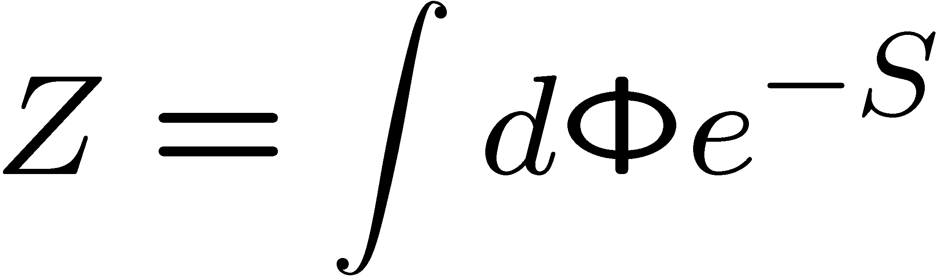
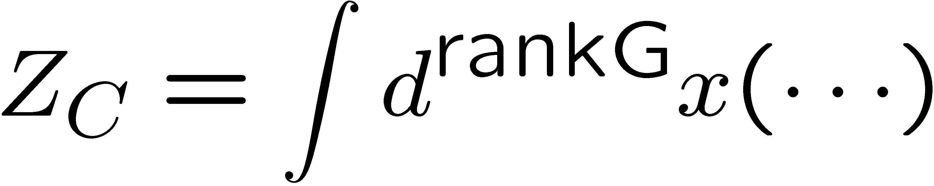
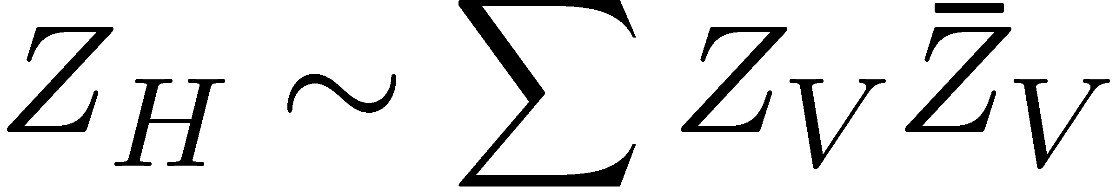

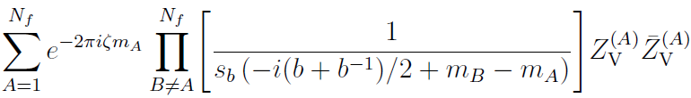
Our strategy
We study partition function of SUSY gauge theory on S_{b}³ and S²xS¹
“Coulomb branch localization”
“Higgs branch localization”
Localization
w/ certain deformation
Localization
w/ different deformation
[Hama-Hosomichi-Lee ’11,
Imamura-Yokoyama, etc…]
Explicit
evaluation
[Pasquetti, Taki, etc…]
Ex.) SQED
Ex.) SQED

Slide 4
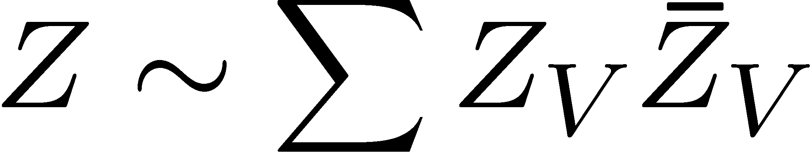
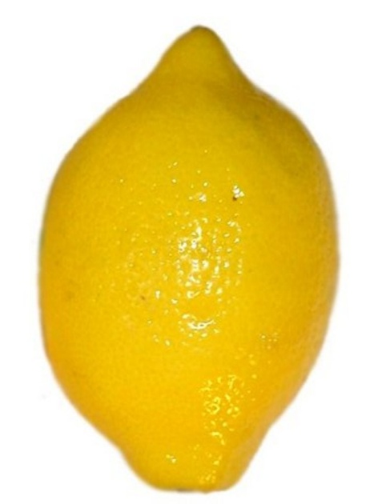
Quick Conclusion
[A work with few overlaps: Chen-Chen-Ho ]
[A work with substantial overlaps: Benini-Peelers
(appeared 10 days later from our paper) ]
on squashed S³ and S¹xS²
x
S¹
S²
squashed S³
New deformation term
Saddle points = Vortices!

Slide 5
Contents
1. Introduction & Motivation
2. Coulomb branch localization
3. Higgs branch localization
4. Vortex partiton function
5. Summary & Outlook

Slide 6
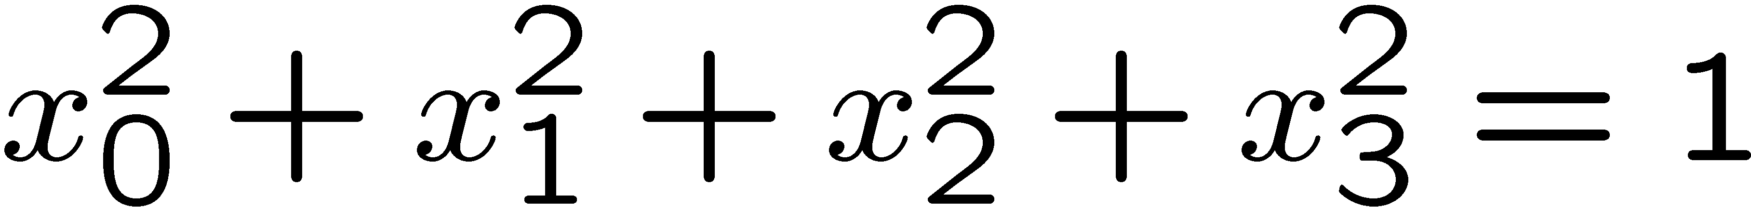
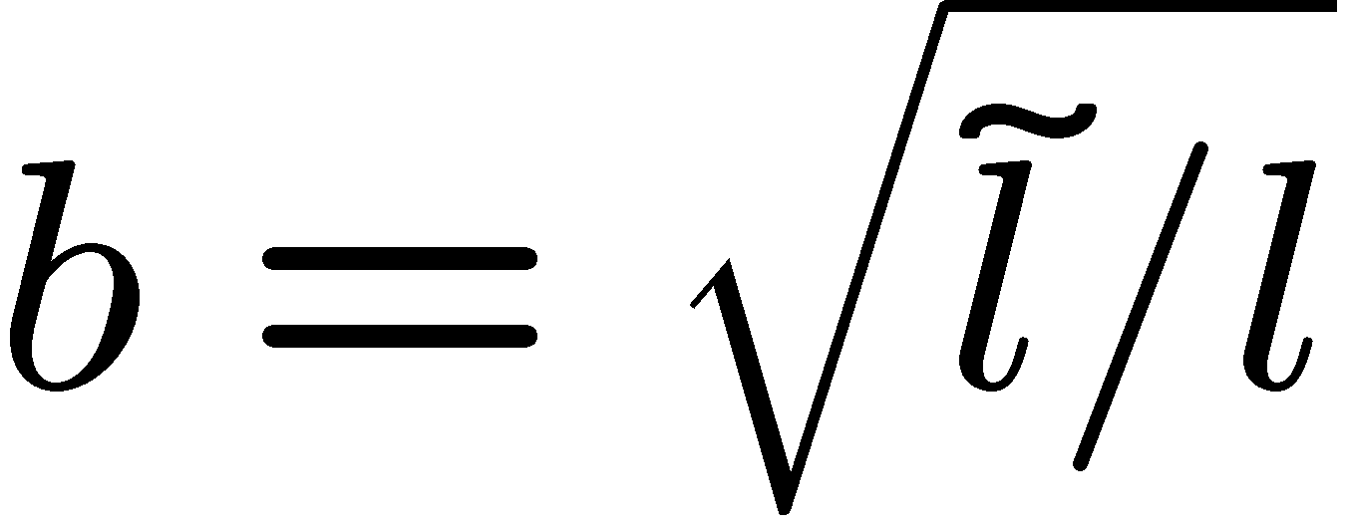

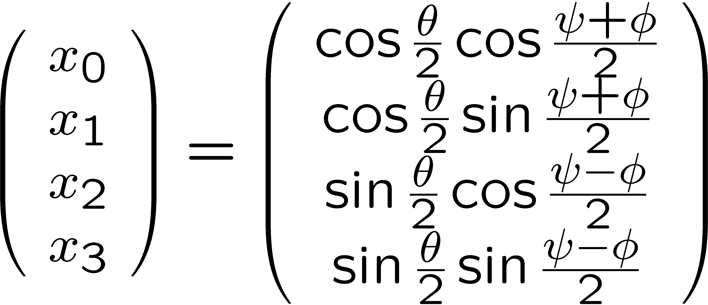

Squashed S³ = S_{b}³
[Hama-Hosomichi-Lee ‘11]
・ We consider 3d ellipsoid:
[Cf. Universality among several squashed spheres:
Closset-Dumitrescu-Festuccia-Komargodski ’13 ]
Hypersurface:
in
= 1-parameter deformation of usual S³ by parameter
・ We can take “Hopf-fibration” coordinate:

Slide 7
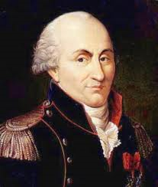
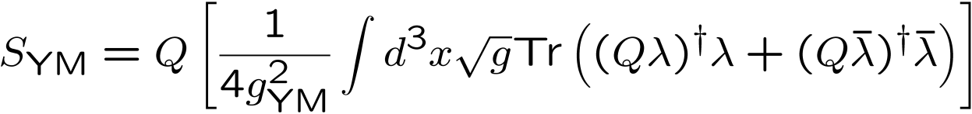
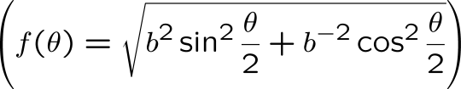
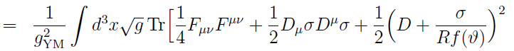
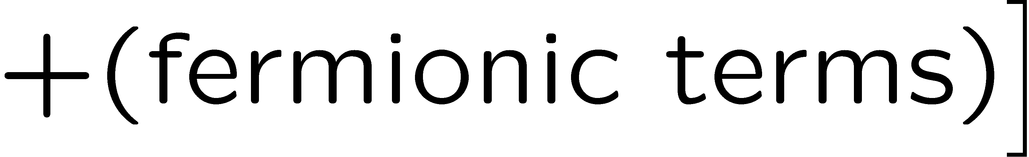
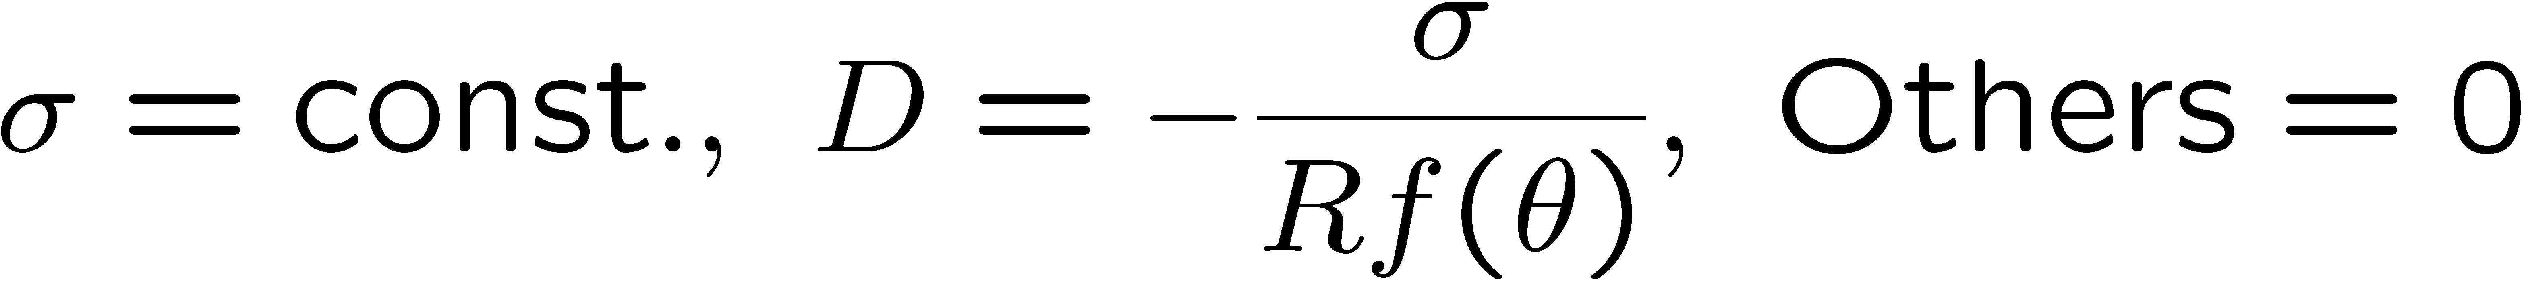
Super Yang-Mills
Action = Q-exact:
Positive definite!
Choose the deformation term “QV” = The Action itself
Localized configuration:
(up to gauge trans.)
Coulomb branch solution!

Slide 8
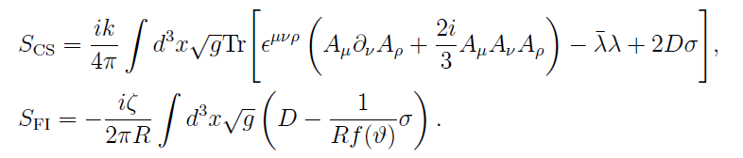
Adding CS- & FI-terms
We can also add Chern-Simons and Fayet-Illiopoulos terms:
These are not Q-exact but Q-closed → only classical contribution
Ex.) U(N) SYM with CS- and FI-terms:

Slide 9
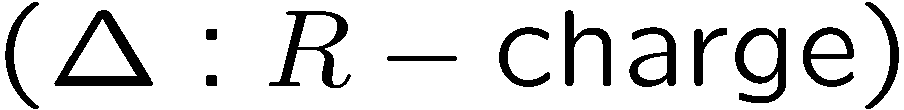
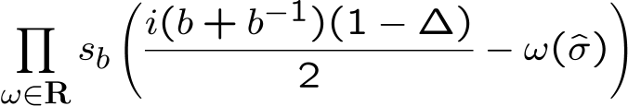

Adding Matter
・ We choose
・ We can perform completing square:
Combined with the SYM action, again
Localized configuration:
Coulomb branch
(Effect of matter)
=
Insertion of

Slide 10
Short summary
Partition function of general SUSY gauge theory on S_{b}³:
It is hard to perform the integration for general N…
Higgs branch localization automatically performs
these integrations!!

Slide 11
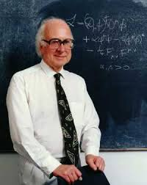
From Coulomb
To Higgs

Slide 12
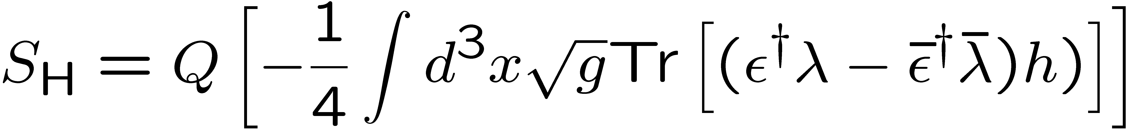
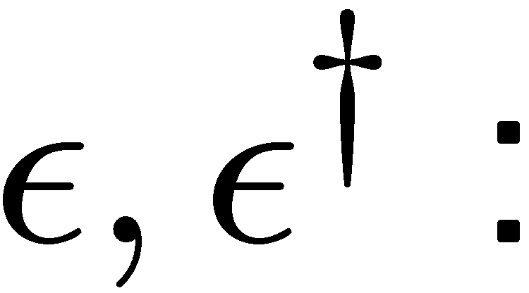
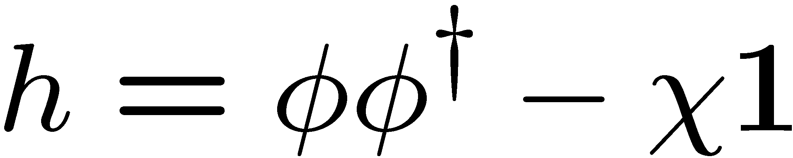
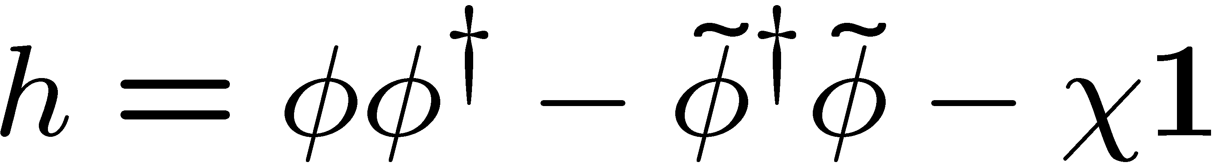
From Coulomb to Higgs
[Actually this is import from 2d
cf. Benini-Cremonesi ’12,
Doroud-Gomis-Floch-Lee ’12 ]
We use a different deformation term:
New!!
where
h : a function of scalars depending on setup
SUSY trans. parameter (bosonic spinor)
Ex. 1)
For
SYM + fundamental matters
(χ：Constant)
Ex. 2)
Adding anti-fundamental
Ex. 3)
Adding adjoint

Slide 13
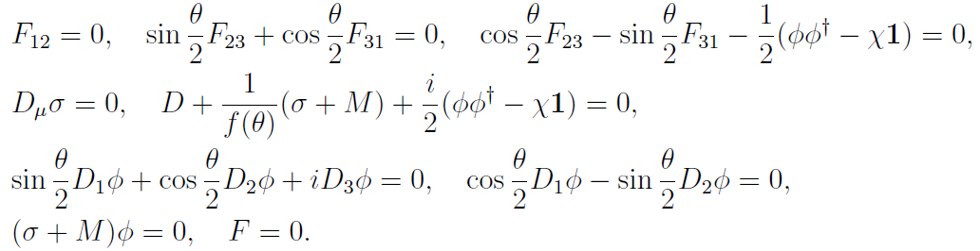
Localized configuration
For simplicity,
let’s consider SQCD with mass matrix M & Δ=0:
Complicated…
We solve these conditions in the following criterions:
[cf. Pestun, Hama-Hosomichi, etc..]
① Demand smoothness
away from the north and south poles
② Allow singularity at the north and south poles

Slide 14
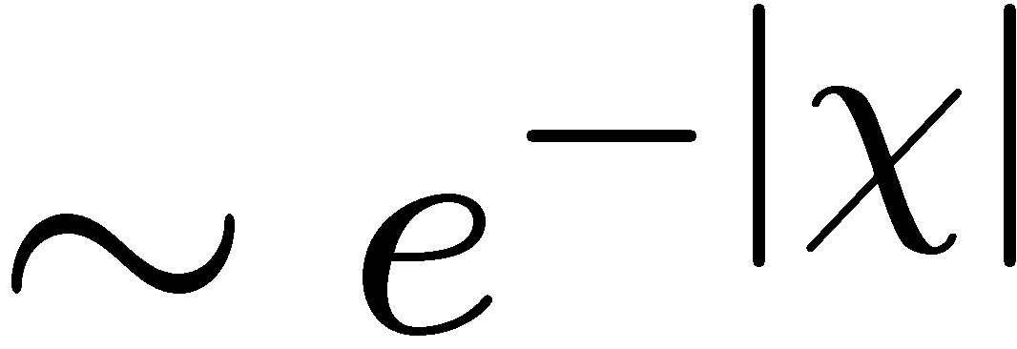
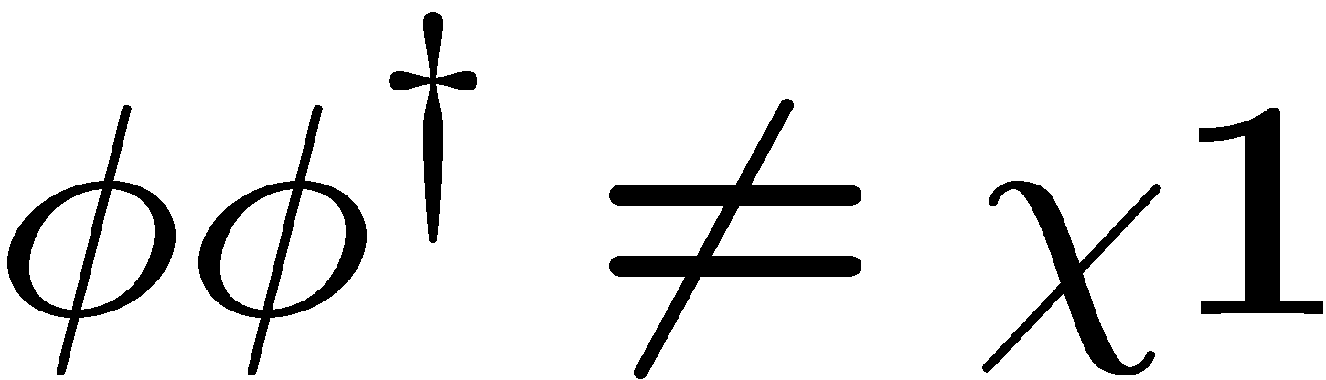
Away from the north and south poles
① Demanding smoothness, we find
② We can show
Contribution from
③ Recalling that χ appears only in deformation term,
(final result)
=
(χ-independent )
④ If we take χ→∞, nonzero contribution comes from
Higgs branch!

Slide 15



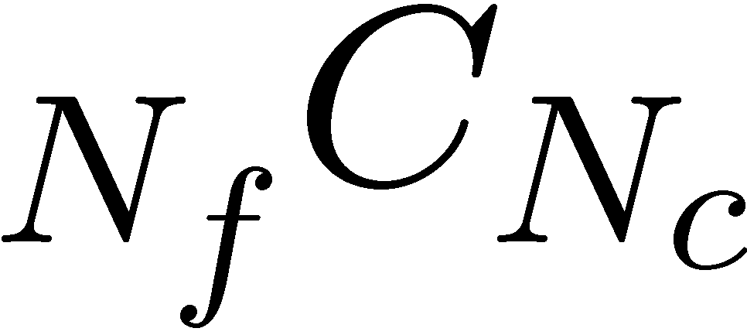
Away from the north and south poles (Cont’d)
Localized configuration:
With explicit indices,
If φ is eigenvector of M, φ must be also eigenvector of σ.
Then, up to flavor and gauge rotation,
Path integral becomes just summation
over discrete combinations!

Slide 16

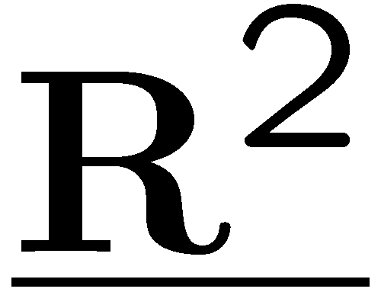
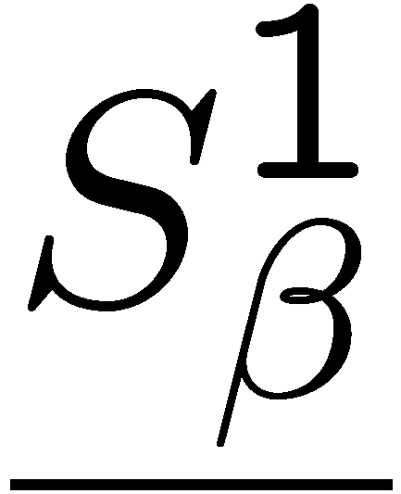
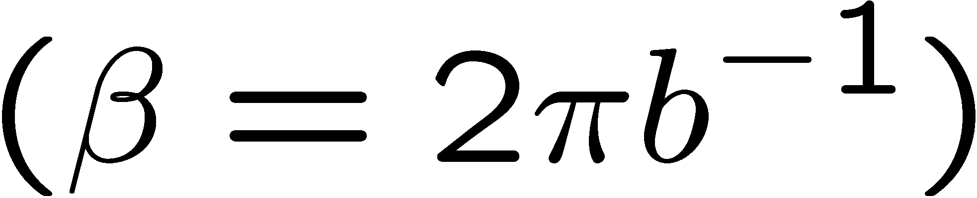
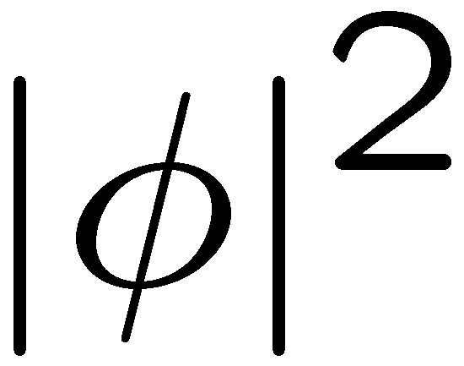
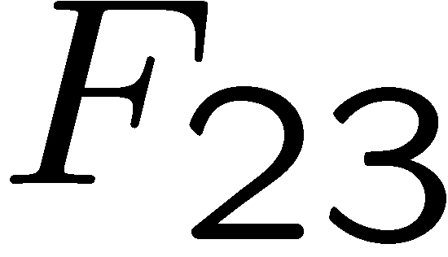



At north pole
Localized configuration:
Vortex equation!
Zoom up around θ=0
x
Point-like vortex!

Slide 17

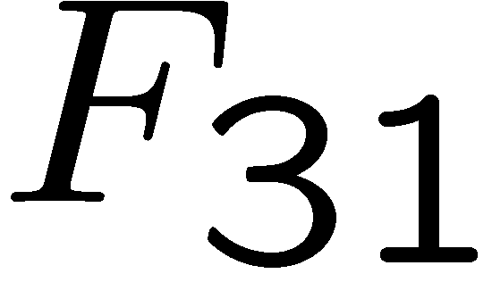


At south pole
Localized configuration:
Anti-vortex equation!
x
Zoom up around θ=π
Point-like vortex!

Slide 18
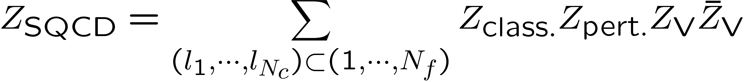

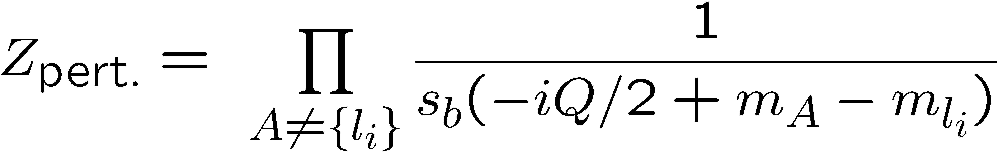
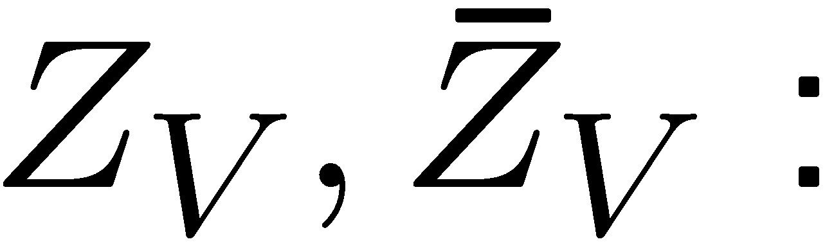
Total expression
Thus, we obtain
where
(anti-)vortex partition function
If we know (anti-)vortex partition function, we can get exact result!
Compute vortex partition function!!

Slide 19
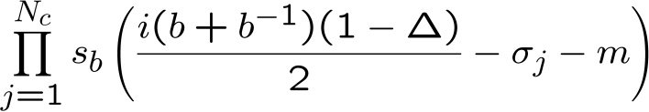

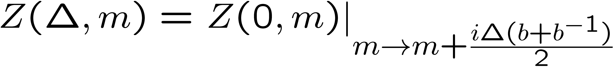
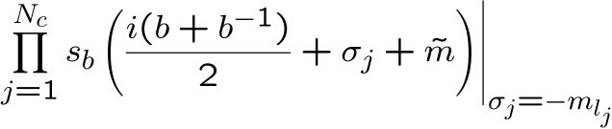
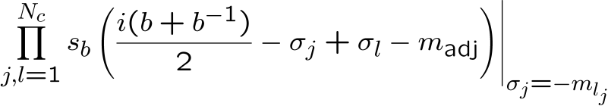
Remarks
・General R-charge assignment
Effect of matter
in Coulomb branch formula
=
Insertion of
From the Coulomb branch formula,
we know that the partition function is holomorphic in
Hence,
・Other field contents
[ cf. Fujimori-Kimura-Nitta-Ohashi]
Fundamental, anti-fundamental and adjoint cannot have VEV simultaneously
=
1-loop of anti-fundamental
Insertion of
=
1-loop of anti-fundamental
Insertion of
Contribution to vortex partition function is nontrivial.

Slide 20
Vortex partition function

Slide 21
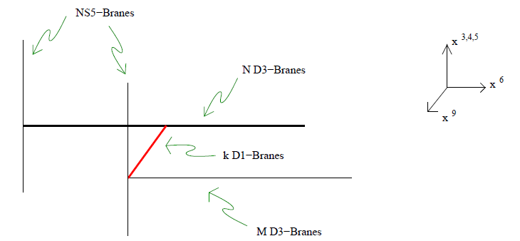

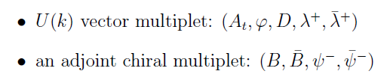
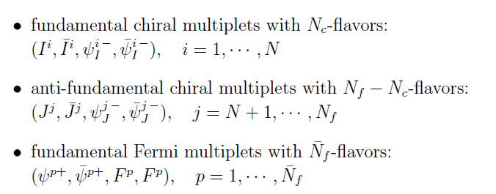

Vortex quantum mechanics
[ Hanany-Tong]
If we have a brane construction, we can read off vortex quantum mechanics.
Ex.) U(N) SQCD with Nf-fundamental hypermultiplets

Slide 22

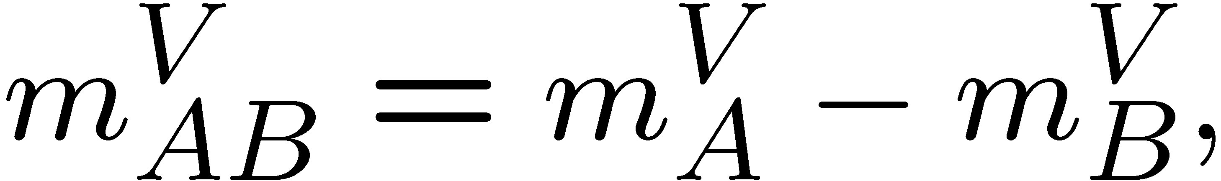
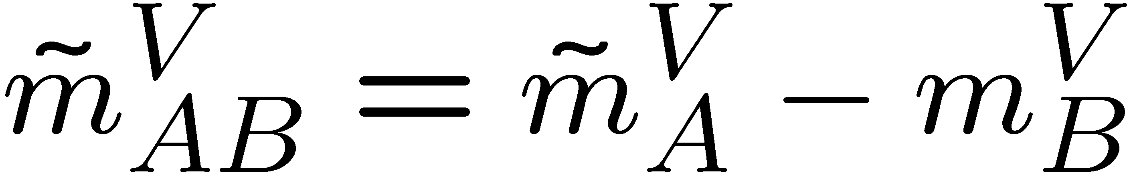
Vortex partition function
By applying localization method to the vortex quantum mechanics,
we can compute vortex partition function.
where
ζ: FI-parameter, ε: Ω-background parameter, β: S¹-radius

Slide 23


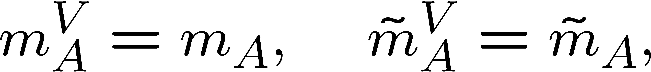
Identification of parameters
We must translate vortex language into the original setup.
・S¹-radius β = Hopf-fiber radius
・Ω background parameter ε = Angular rotation parameter
From SUSY algebra,
・Equivariant mass m^{V}
If we naively take
this does not agree with the Coulomb branch results…

Slide 24
Mass identification problem
If we naively take
this does not agree with the Coulomb branch results…
However, if we take
this agrees with the Coulomb branch result for all known cases.
(We haven’t found this justification from first principle yet.)
This would be similar to Okuda-Pestun Problem for instanton partition function
in 4d N=2* theory
[ Okuda-Pestun]

Slide 25
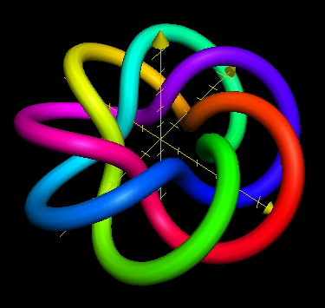



BPS Wilson loop
This preserves SUSY when the contour is
[Tanaka ’12]
(from Wikipedia)
Torus knot!
Noting
(Effect of Wilson loop )
Insertion of

Slide 26
Summary & Outlook

Slide 27
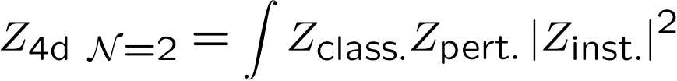
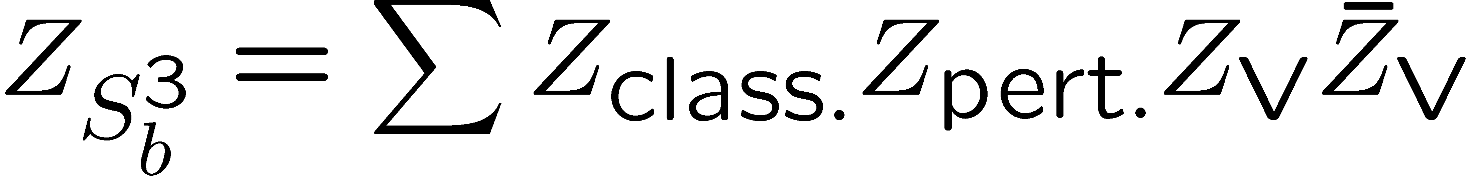
Summary
Cf.
・ We have directly derived
・ The vortices come from
x
S¹
S²
・ BPS Wilson loop also enjoys factorization property

Slide 28
Obvious possible applications
・ Study different observables
Vortex loop
[Coulomb branch localization:
Drukker-Okuda-Passerini ’12, Kapustin-Willett-Yaakov ’12]
・ Work on different spaces
S_{b}³/Z_{n}
[Coulomb branch localization: Imamura-Yokoyama ’12]
A subspace of round S³ with Dirichlet boundary condition
[Coulomb branch localization: Sugishita-Terashima ’12]
・ Work in higher dimensions (including S² in a sense)
4d superconformal index
[Coulomb formula: Kinney-Maldacena-Minwalla-Raju ’05, etc]
S²xT²
[Some rich structures? : Cecotti-Gaiotto-Vafa ’13]

Slide 29

Some interesting directions
・Vortex partition functions are known for very limited cases
We don’t know even “what is moduli?” for many cases
It is very interesting if we get vortex partition function for M2-brane theories
・Vortex partition function is related to topological string
Can we more understand relation between ABJ and topological string ?
(on local P¹ x P¹)
・Partition function on S_{b}³ ~ Renyi entropy of vacuum in 3d CFT
[Nishioka-Yaakov ’13]
What does the vortex structure imply?

Slide 30
Thank you

Slide 31
Appendix

Slide 32
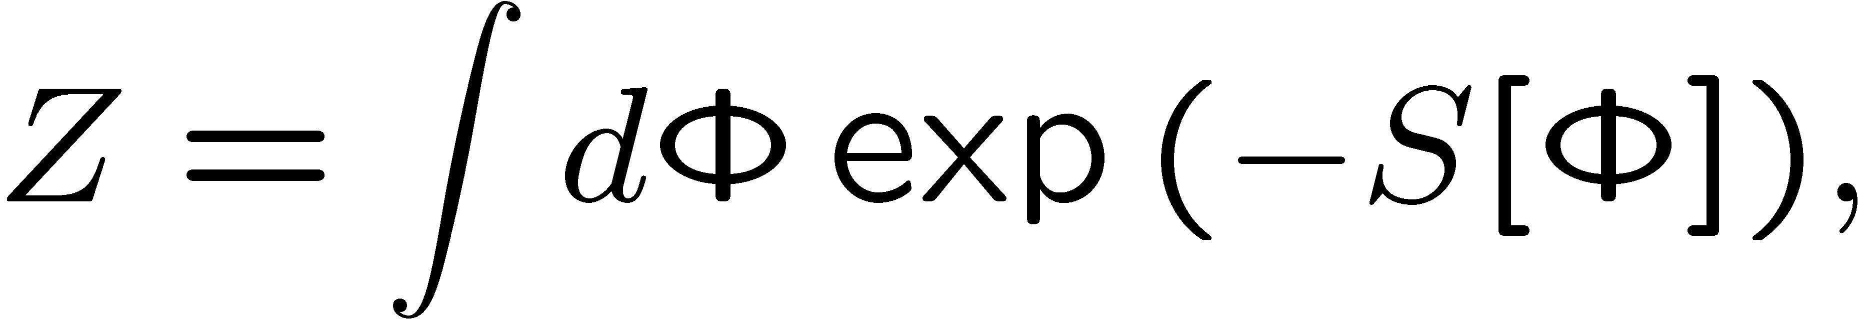


Localization method
Original partition function:
[Cf. Pestun ’08]
where
1 parameter deformation:
Consider t-derivative:
Assuming Q = non-anomalous
We can use saddle point method!!

Slide 33



(Cont’d) Localization method
Consider fluctuation around saddle points:
where
Cf.
For Q-invariant operator,

Slide 34








Some conventions

Slide 35







SUSY on 3d manifold
Killing spinor equation:
Solution:

Slide 36


Action & SUSY trans.(vector)

Slide 37


Action & SUSY trans.(matter)

Slide 38

Deformation term for Higgs branch localization

Slide 39
Vortex quantum mechanics

Slide 40

Vortex quantum mechanics (Cont’d)

Slide 41




Vortex quantum mechanics (Cont’d)
Saddle points:

Slide 42



Vortex quantum mechanics (Cont’d)

